Slide 1



DATA-DRIVEN CONCERT STRATEGY
Powered by Data Insights from the Top 50 Global Tracks
QUOTE: WITHOUT DATA, YOU’RE JUST ANOTHER PERSON WITH AN OPINION
- W. EDWARDS DEMING
EWAKISI
DEI
CARLOS
THEOPHILUS
NEXT

Slide 2






PROJECT
OVERVIEW
Dataset: Spotify Global Top 50 Songs
Source: Kaggle/Spotify (CSV)
Goal: Use listener trends to design concert strategies.
Hypothesis:
- High energy + danceability = popular
songs.
- Pop dominates in quantity, but niche
genres are strong in quality.
- Artists with multiple hits = good long-
term bookings.

Slide 3
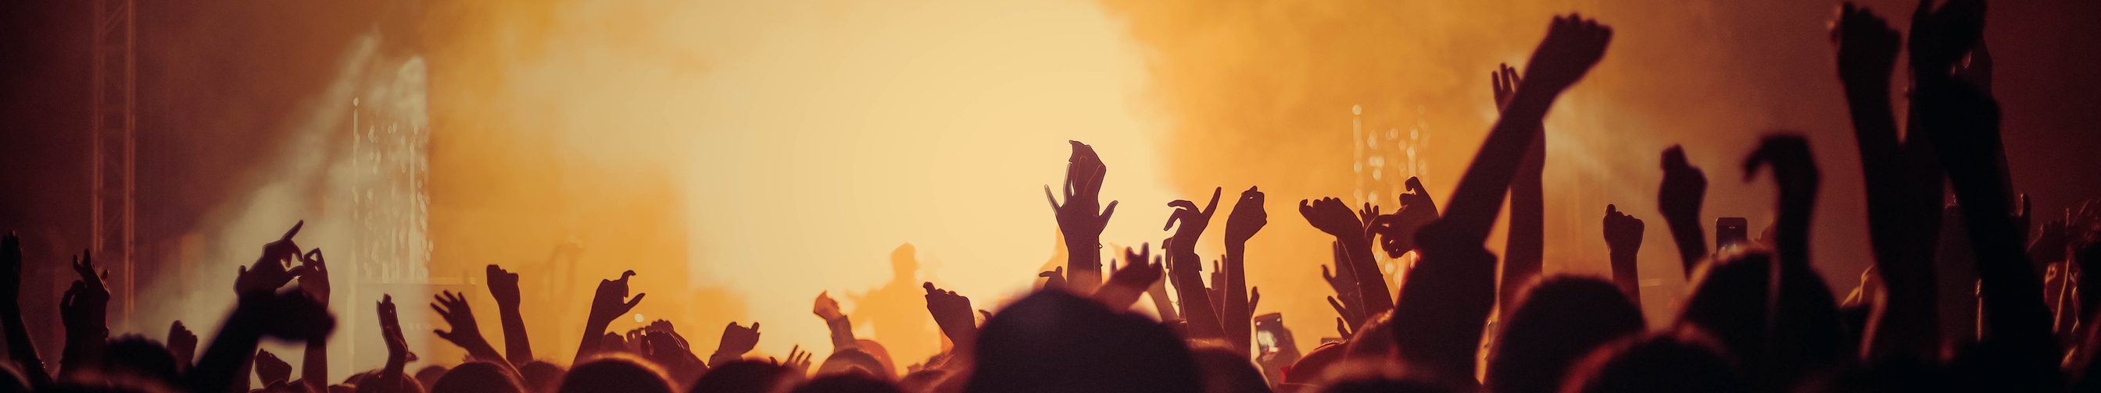
DATA ACQUISITION AND EXAMINATION
1
Used Python (pandas) to clean the data
3
Challenges: encoding, formatting, SQL issues.
2
Tasks: Rename columns, normalize 0-1, and remove duplicates.
4
One main dataset with 50 songs and 13 variables.

Slide 4
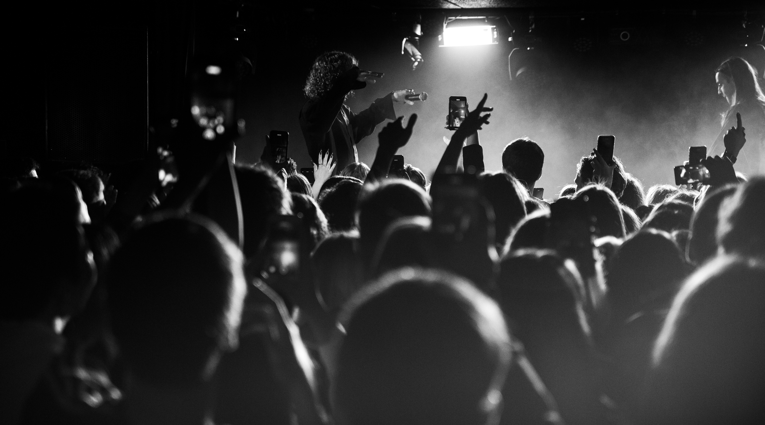
Database Design and Transformation
Database Tables: Artists, Genres, Tracks.
Created foreign keys for normalization
Data transformations included: genre/ artist IDs, scaling, dropping nulls
Loaded into MySQL using ‘CREATE’ + ‘INSERT’ scripts

Slide 5
SQL INSIGHTS & ANALYSIS
Queries used: JOIN, GROUP BY, HAVING, subqueries.
Revealed top genres (Dance Pop, Pop)
Identified high-energy party tracks with low acousticness.
Subqueries helped track average artist performance.

Slide 6



"WE MAKE MUSIC"
KEY DATA DRIVEN INSIGHT
·Popular tracks = energy > 0.6 & danceability > 0.6
Top examples: 'Ransom', 'China', 'bad guy'
·Genres like Reggaeton, Electropop top in avg popularity
·Bad Bunny & Post Malone have multiple high-popularity songs
www.reallygreatsite.com
Page1

Slide 7




PROGRAMMING STRATEGY
ENERGY & DANCEABILITY > 0.6
RANSOM, CHINA, BAD GUY
REGGAETON, ELECTROPOP
BAD BUNNY, POST MALONE
Popular
Top Songs
Hot Genres:
Top Artists

Slide 8
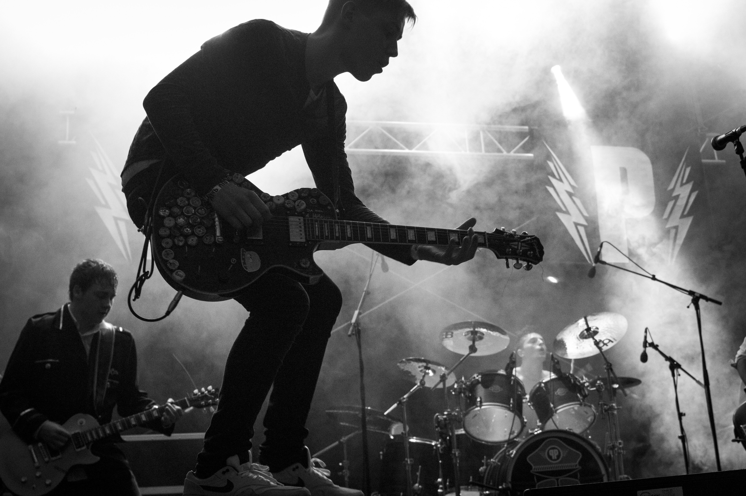




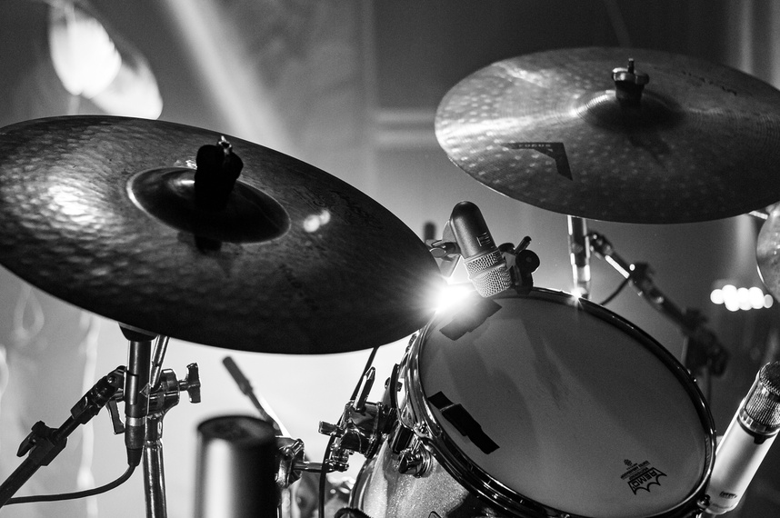

PROGRAMMING
STRATEGY
We use data-driven insights to craft optimized setlists by scheduling high-energy tracks during peak hours, blending popular genres like Pop with top-performing niche styles, and prioritizing artists who consistently generate strong audience engagement.

Slide 9


Studio Shodwe
CONCLUSIONS & BUSINESS IMPLICATIONS
Our analysis confirms that tracks with high energy and danceability tend to be more popular. While Pop remains a strong core genre, niche genres help build fan loyalty. These insights empower targeted artist bookings, smarter setlist planning, and enhanced crowd engagement—ultimately boosting both audience satisfaction and business profitability.
Page | 03

Slide 10

Studio Shodwe
OUR MISSION
main issues
Root cause
·Trying to insert tracks before inserting artists/genres
SQL foreign key constraint errors
Lesson Learned
Improvement
Load reference data first (load order matters)
·Improved understanding of database design & integrity
Page | 06

Slide 11

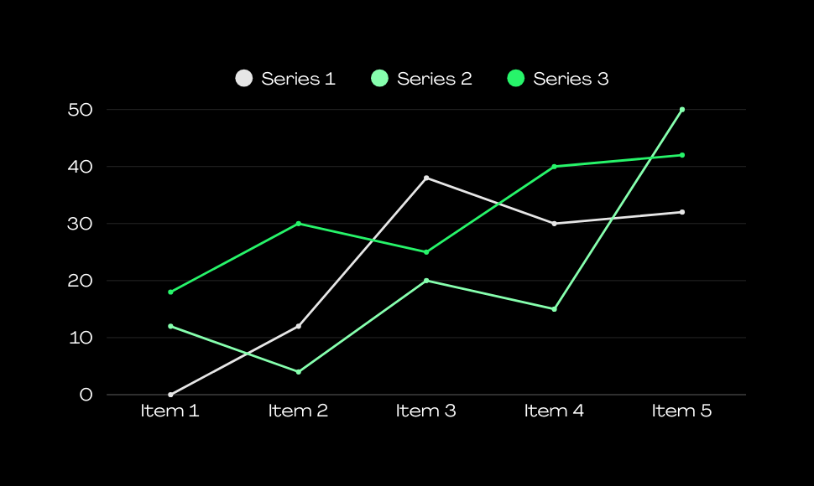
CONCERT VISITOR
STATISTICS
A presentation is a method of communicating information, ideas, or proposals to an audience. It typically involves a speaker or speakers delivering content using visual aids such as slides, charts, graphs, or multimedia elements to enhance understanding and engagement. Presentations can occur in various settings, including business meetings, academic lectures, conferences, and seminars. The goal of a presentation is often to inform, persuade, or educate the audience on a particular topic or subject matter. Effective presentations are well-structured, clear, and engaging, capturing the attention of the audience and delivering the intended message effectively.

Slide 12
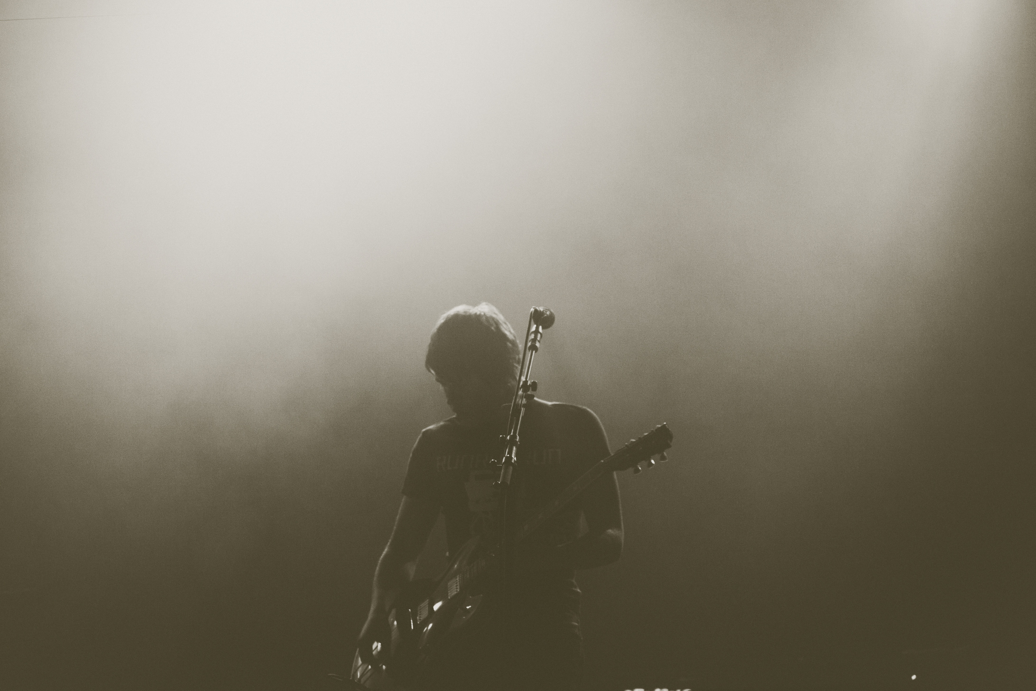
THANK'S FOR LISTENING
'WITHOUT DATA, YOU'RE JUST ANOTHER PERSON WITH AN OPINION.'

